Slide 1

 | National University of Sciences & Technology (NUST) School of Electrical Engineering and Computer Science (SEECS) Department of Humanities & Sciences
Expository Writing
ENGL-101
Week 6: Lecture # 2
Course Instructor: Dr Samia Tahir
1

Slide 2
Today’s Lecture
Graphics in expository writing
The benefits of using graphics or visuals
When not to use graphics?
Basic graphics principles
Various types of graphics
Types of graphics: Figures and Tables

Slide 3
Read this!
According to research from eMarketer, two out of three Americans in 2013 used social networking sites, like Facebook, Twitter, and YouTube. Over the last four years, this percentage has grown for all age cohorts. For example, in 2010, approximately 83 percent of people aged 12 to 24 used social networking sites. This percentage grew to 86 percent in 2011, 88 percent in 2012, and 89 percent in 2013. In 2010, 71 percent of Americans between the ages of 25 to 44 visited social media sites. This percentage grew to 77 percent in 2011, 80 percent in 2012, and 81 percent in 2013. For the 45-to-64-year-old cohort, social media visitation was 51 percent in 2010. This percentage grew to 55 percent in 2011. In 2012, 59 percent of people aged 45 to 64 visited social media sites. Finally, in 2013, this percentage grew to 61 percent. Overall, in 2013, 67 percent of Americans visited social networking sites. (“2 out of 3”)

Slide 4
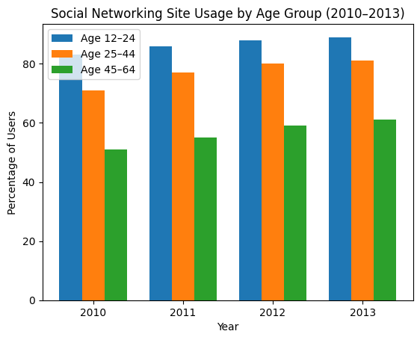

Slide 5
The Benefits of using Graphics
1. Conciseness:
Large amount of data in a small space.
Delete many unnecessary words and phrases.
2. Cosmetic appeal:
Break up the monotony of wall-wall words.
Sustain your reader’s interest

Slide 6
The Benefits of using Graphics
3. Clarity:
Can clarify complex information, such as trends, comparison, percentages, facts and figures.
Reinforce certain ideas.
Makes data easier to interpret and remember
Visuals reveal meanings of ideas which are otherwise buried in the text.

Slide 7
When not to use Graphics?
When you have not mentioned them (Figures/tables) in the text.
When you know your audience will not like it.
When the graphics being used is diverting the attention of the reader.
When they are used to only dressing up your document instead of enhancing your audiences’ learning/understanding.

Slide 8
Basic graphic principles
avoid clutter,
orient the image properly,
be aware of scale,
always verify content, and
avoid any graphic that is extraneous.

Slide 9
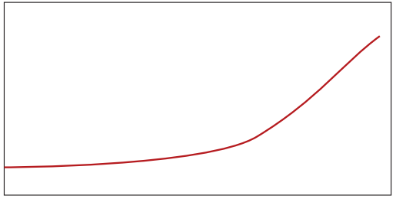
What can you infer?
The time required for global population to grow from 5 to 6 billion was shorter than the interval between any of the previous billions. It took just 12 years for this to occur, just slightly less than the 13 years between the fourth and fifth billion, but much less time than the 118 years between the first and second billion...

Slide 10
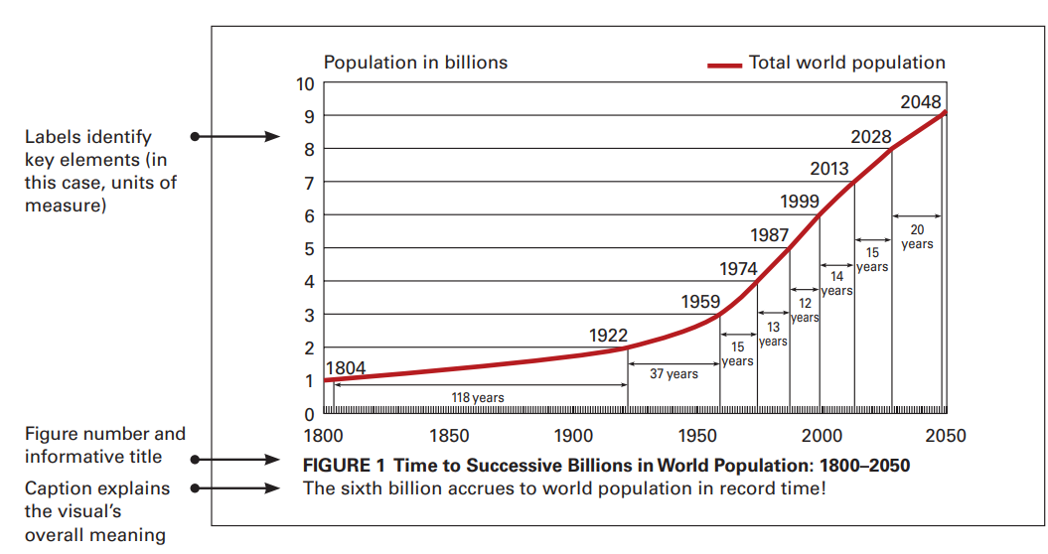

Slide 11
Types of Graphics
Numbers:
Tables
Graphs
Bar graphs
Line graphs
Pie graphs
Maps
Concepts:
Charts
Flow Charts
Organizational charts
Scheduling Charts
Objects:
Photographs
Figures/Illustrations
Drawings
Diagrams
Schematics
• Words - Words emphasized by boxing them, by changing the color or the font, or enlarging them to call attention in a text are all forms of graphics, albeit not very sophisticated.

Slide 12
Types of Graphics: Tables
Tables provide columns and rows of information.
A table is used to make factual information, such as numbers, percentages, and monetary amounts, easily accessible and understandable.

Slide 13
Guidelines for creating tables
Explain what the table contains and how it will help the reader.
Give the table either a title or caption, as appropriate.
Write informative, understandable, and visually distinct heading labels.
Make rows distinct through headings or display of categories.
Avoid wordiness, limit text in cells to a few words.
Use color coding and symbols to facilitate quick scanning and data comparison.
Ensure the table will be readable in the display format.

Slide 14
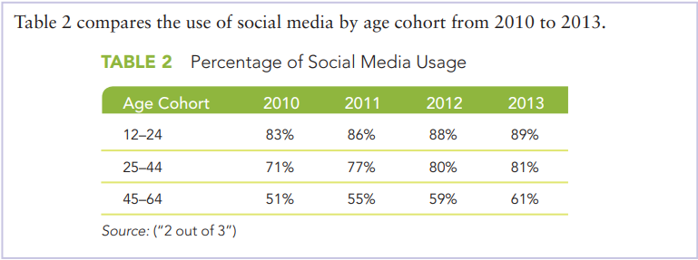
Example

Slide 15
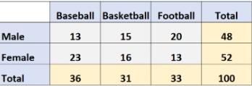
Give a caption to this Table

Slide 16
Types of Graphics: Figures
Another way to enhance your technical communication is to use figures.
Whereas tables eliminate needless repetition of words and clarify quantifiability, figures highlight and supplement important points in your writing.

Slide 17
Guidelines for creating figures
Number figures in order of presentation (i.e., Figure 1, Figure 2, Figure 3).
Title each figure. When you refer to the figure, use its number rather than its title: Figure 1 shows the relation between the average estimated price for houses and the actual sales prices.”
Preface each figure with an introductory sentence.
Avoid using a figure until you have mentioned it in the text.
Present the figure as soon as possible after mentioning it instead of several paragraphs or pages later.
After you have presented the figure, explain its significance. Don’t let the figure speak for itself. Remind the reader of the important facts you want to highlight.

Slide 18
Bar graphs
Bar charts show either vertical bars or horizontal bars.
These bars are scaled to reveal quantities and comparative values.
You can shade, color, or crosshatch the bars to emphasize the contrasts. If you do so, include a legend explaining what each bar represents.

Slide 19
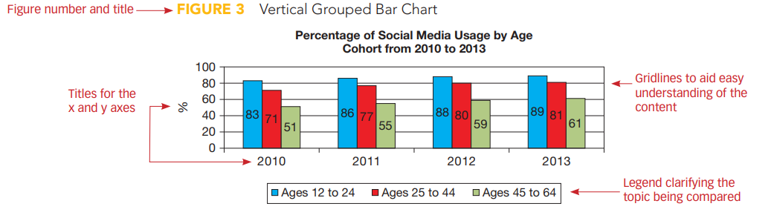
Vertical bar graph

Slide 20
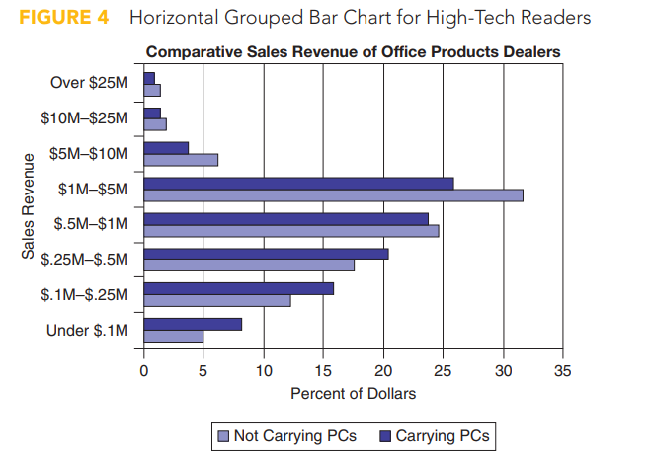
Horizontal bar graph

Slide 21
Pie charts
Use pie charts to illustrate portions of a whole.
The pie chart represents information as pie-shaped parts of a circle.
The entire circle equals 100 percent or 360 degrees. The pie pieces (the wedges) show the various divisions of the whole.

Slide 22
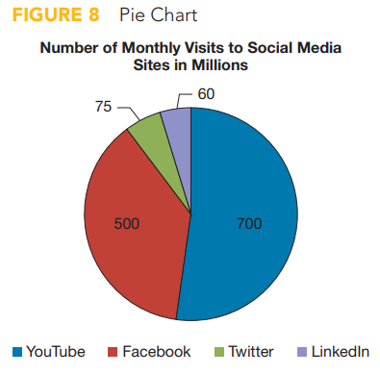
Pie chart

Slide 23
Line charts
Line charts reveal relationships between sets of figures.
To make a line chart, plot sets of numbers and connect the sets with lines.
The lines create a picture showing the upward and downward movement of quantities.

Slide 24
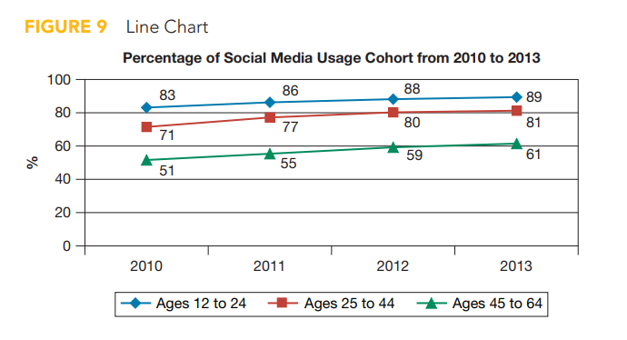
Line chart

Slide 25
Flow charts
You can show chronological sequence of activities using a flowchart.
Flowcharts are especially useful for writing technical instructions.
When using a flowchart, remember that ovals represent starts and stops, rectangles represent steps, and diamonds represents equal decisions.

Slide 26
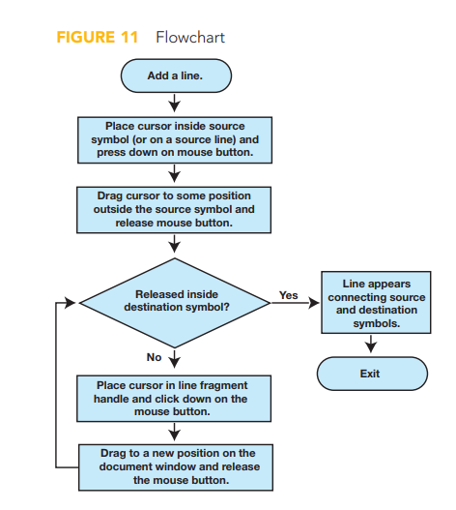
Flow chart

